Slide 1
Context-dependent phone models
Most slides come from http://www.inf.ed.ac.uk/teaching/courses/asr/2020-21/asr05-hmm-algorithms.pdf
Ying shen
School of software engineering
Tongji university

Slide 2
Content
Modelling phones with HMMs
The need to model phonetic context
Biphone and triphone models
Parameter sharing – sharing parameters across different contexts
Choosing which states to share – phonetic decision trees

Slide 3
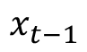
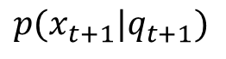

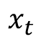
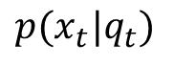
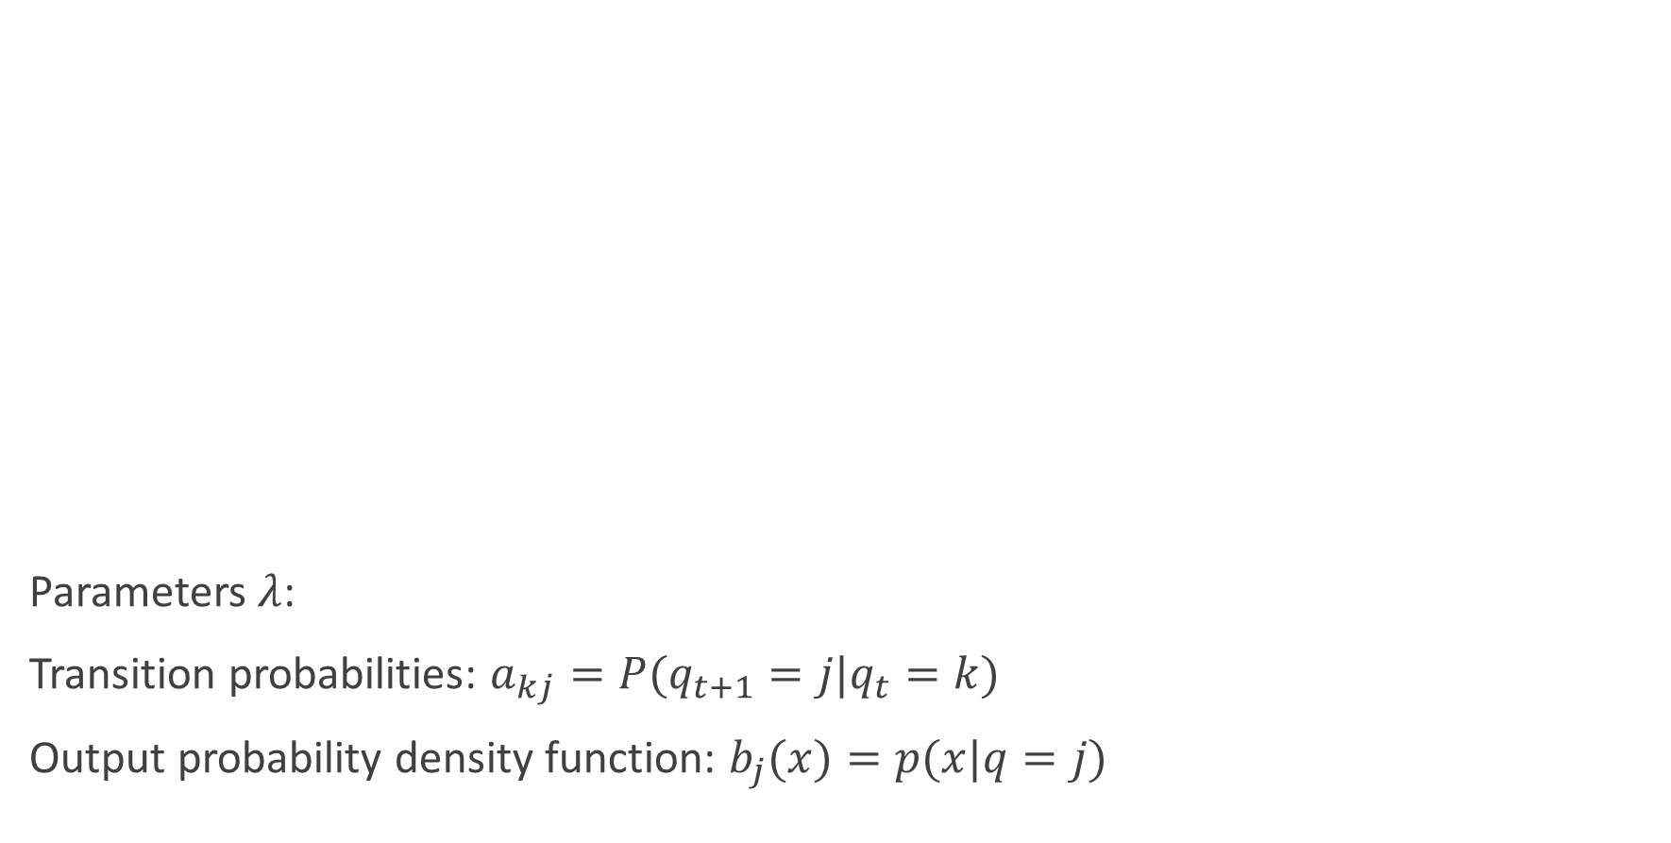
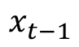
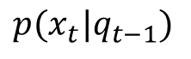

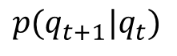

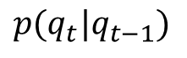
Recap: Continuous Density HMM
Parameters $λ$:
Transition probabilities: $a_{kj}=P(q_{t+1}=j|q_{t}=k)$
Output probability density function: $b_{j}(x)=p(x|q=j)$
$$p(q_{t}|q_{t−1})$$
$$p(q_{t+1}|q_{t})$$
$$q_{t−1}$$
$$q_{t}$$
$$q_{t+1}$$
$$p(x_{t}|q_{t−1})$$
$$p(x_{t}|q_{t})$$
$$p(x_{t+1}|q_{t+1})$$
$$x_{t−1}$$
$$x_{t}$$
$$x_{t−1}$$
Probabilistic finite state automaton

Slide 4
Modelling words with HMM phone models
r1
r2
r3
ai1
ai2
ai3
t1
t2
t3
/r/
/ai/
/t/
“right”

Slide 5
Modelling words with HMM phone models
r1
r2
r3
ai1
ai2
ai3
t1
t2
t3
/r/
/ai/
/t/
“right”

Slide 6
Another example
Single emitting state per phone
s
ih
k
s
“six”

Slide 7
Three emitting states per phone
s1
s2
s3
ih1
ih2
ih3
k1
k2
k3
s1
s2
s3
/s/
/ih/
/k/
/s/
“six”

Slide 8
Three emitting states per phone
s1
s2
s3
ih1
ih2
ih3
k1
k2
k3
s1
s2
s3
/s/
/ih/
/k/
/s/
“six”

Slide 9
Word sequence model
…
s1
s2
s3
ih1
ih2
ih3
d1
d2
d3
…
/s/
/ih/
/d/
“six quid”

Slide 10
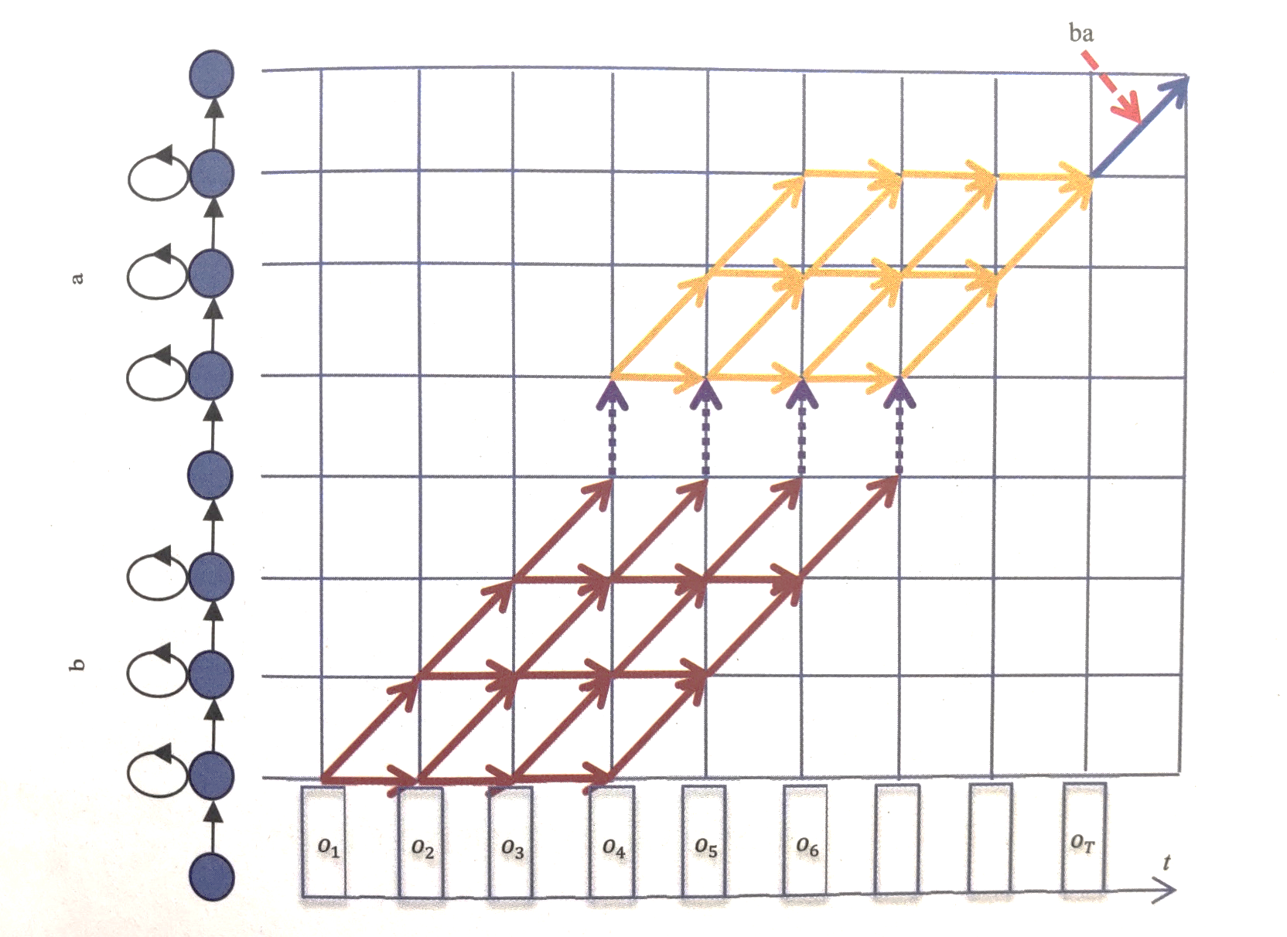
Decoding in concatenated HMMs

Slide 11
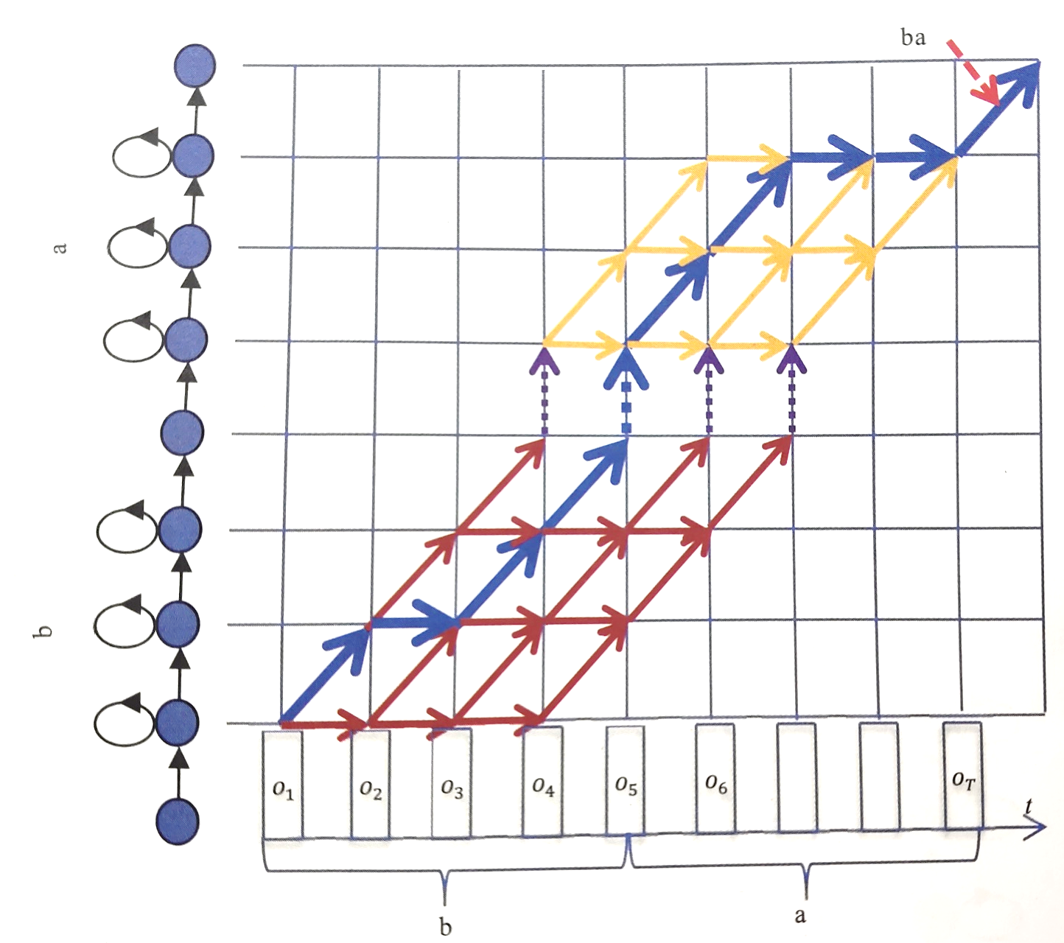
Decoding in concatenated HMMs

Slide 12
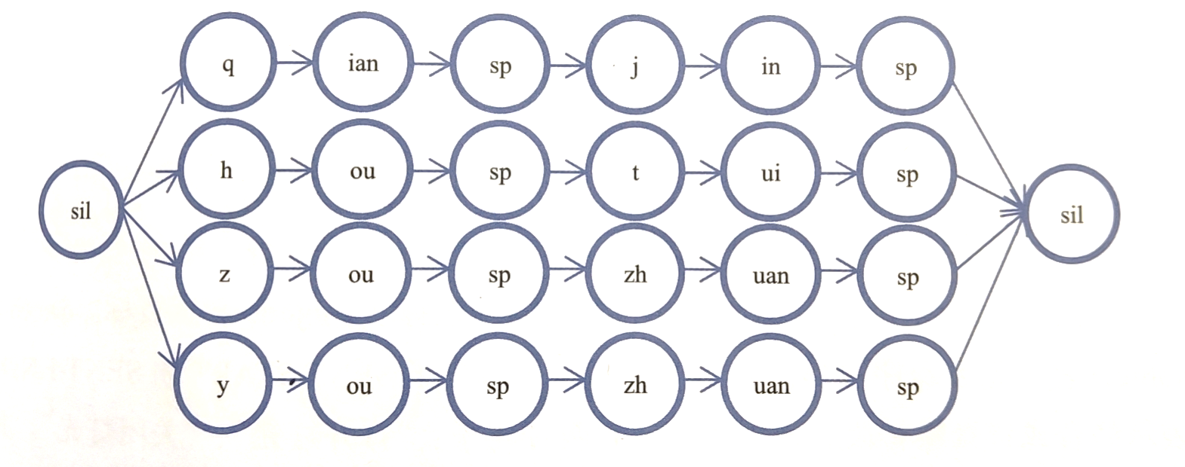
Concatenating HMM for phases
“前进”，“后退”，“左转”，“右转”

Slide 13
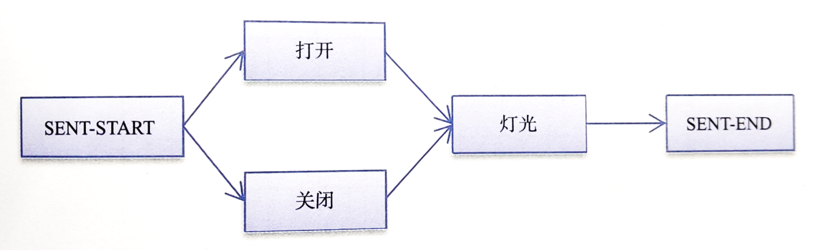
Concatenating HMM for phases
$action = 打开 | 关闭
$object = 灯光
(SENT-START ( $ACTION $OBJECT) SENT-END)

Slide 14
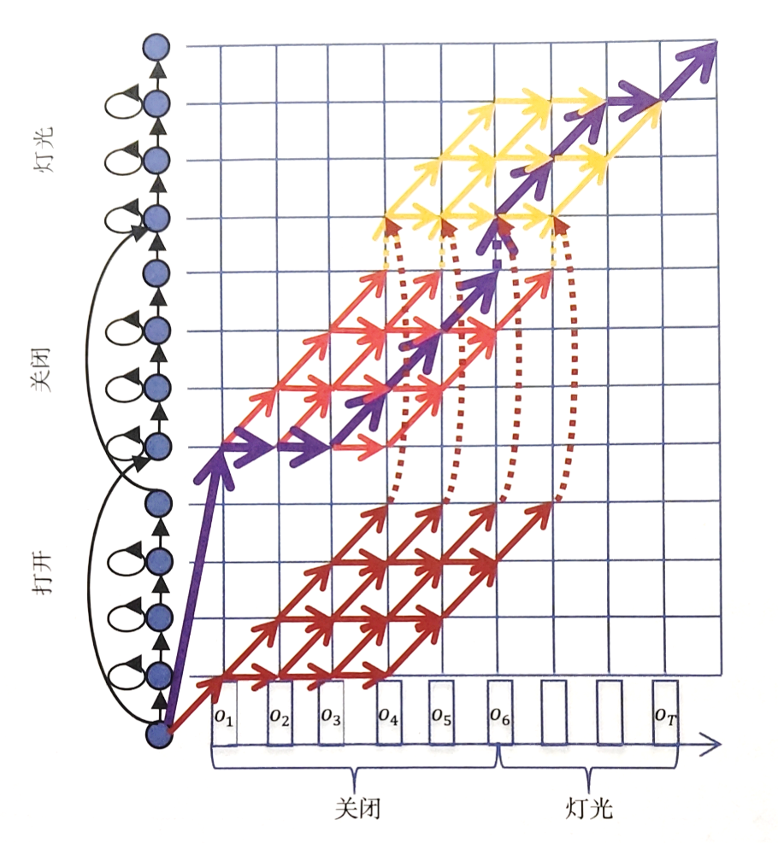
Concatenating HMM for phases

Slide 15
Phonetic Context
Context The acoustic phonetic context of a speech unit has an effect on its acoustic realization
Consider /n/ in ten and tenth
alveolar in ten
dental in tenth
Coarticulation the place of articulation for one speech sound depends on a neighbouring speech sound.
Eg. /n/ in ten pounds vs. ten kilos
More problematic in natural spontaneous speech
Without explicit handling, this violates the Markov assumption!

Slide 16
Phonetic Context Example
t
“tube”
t
“suit”

Slide 17
Modelling Context
Via pronunciations
“did you” d ih jh y ah
“around this” ix r aw n ih s
Via subword units Individual phone units need to deal with a lot of variability
Use longer units that incorporate context, e.g.: biphones, demisyllables, syllables
Use multiple models for each: context-dependent phone models
Context-dependent phones are termed allophones of the parent phone
Notes:
Allophone语位变体:The relatively short [ A ] of mat and the relatively long [ A ] of mad are allophones.

Slide 18
Context-dependent phone models
Biphones Each phone has a unique model for its left or right context (left biphones and right biphones)
Triphones Each phone has a unique model for each left and right context.
Represent a phone x with left context l and right context r as l-x+r
Notes:
大家好
告诉你
不知道
西红柿炒鸡蛋

Slide 19
Example: left biphones
/s/
/s-ih/
/ih-k/
/k-s/
“six”

Slide 20
Example: triphones
/s+ih/
/s-ih+k/
/ih-k+s/
/k-s/
“six”

Slide 21
Advantages of context-dependent models
Context-dependent models are more specific than context-independent models
Increase the detail of modelling by extending the state space - but by defining multiple context dependent models, rather than more complex context independent models
Compensate for the incorrectness of the Markov assumption
Divide and conquer: as more context-dependent models are defined, each one becomes responsible for a smaller region of the acoustic-phonetic space
Let the data tell us how many contexts to model

Slide 22
Types of triphone models
Word-internal triphones Only take account of context within words, so “don’t ask” is represented by: sil d+oh d-oh+n oh-n+t n-t ah+s ah-s+k s-k sil
Word internal triphones result in far fewer models than cross-word models, and enable the subword sequence for a word to be known independent of the neighboring words.
But: context is not well-modelled at word boundaries.
Cross-word triphones “don’t ask” is represented by: sil sil-d+oh d-oh+n oh-n+t n-t+ah t-ah+s ah-s+k s-k+sil sil
Note that triphone context extends across words (eg unit n-t+ah)
Notes:
普通话：27（声母）*38（韵母）*29（声母+sil/sp）=29754个
英语：28（辅音）*20（元音）*30（元音+sil/sp）=16800个

Slide 23
Recognition with context-independent units
t
eh
n
p
ih
n

Slide 24
Context-dependent units
eh-n
t+eh
t-eh+n
eh-n+t
n-t+eh
eh-n+p
ih-n
p+ih
p-ih+n
ih-n+t
n-p+ih
ih-n+p

Slide 25
Triphone models
How many triphones are there? Consider a 40 phone system. 40³ = 64 000 possible triphones. In a cross-word system maybe 50 000 can occur
Number of parameters:
50 000 three-state HMMs, with 10 component Gaussian mixtures per state: 1.5M Gaussians
39-dimension feature vectors (12 MFCCs + energy), deltas and accelerations
Assuming diagonal Gaussians: about 790 parameters/state
Total about 118 million parameters!
We would need a very large amount of training data to train such a system to enable robust estimation of all parameters to ensure that all possible triphones are observed (more than once) in the training data

Slide 26
Modelling infrequent triphones
The number of possible triphone types is much greater than the number of observed triphone tokens.
Smoothing - combine less-specific and more-specific models
Parameter Sharing - different contexts share models
Bottom-up - start with all possible contexts, then merge
Top-down - start with a single context, then split
All approaches are data driven
NB: knowledge is used to make it work effectively

Slide 27
Smoothing: Backing off
Basic idea Use less-specific models when there is not enough data to train a more specific one
For example if a triphone is not observed (or only a few examples are observed) use a biphone model: sh-iy+l → iy+l
If only a few biphone occurrences use a monophone:
sh-iy+l → iy+l → iy
Use a minimum training example count to determine whether a triphone should be modelled or backed-off to a biphone (likewise for biphones)
Ensures that each model is well trained
But training data is sparse (especially when cross-word triphones are used) so relatively few specific triphone models

Slide 28
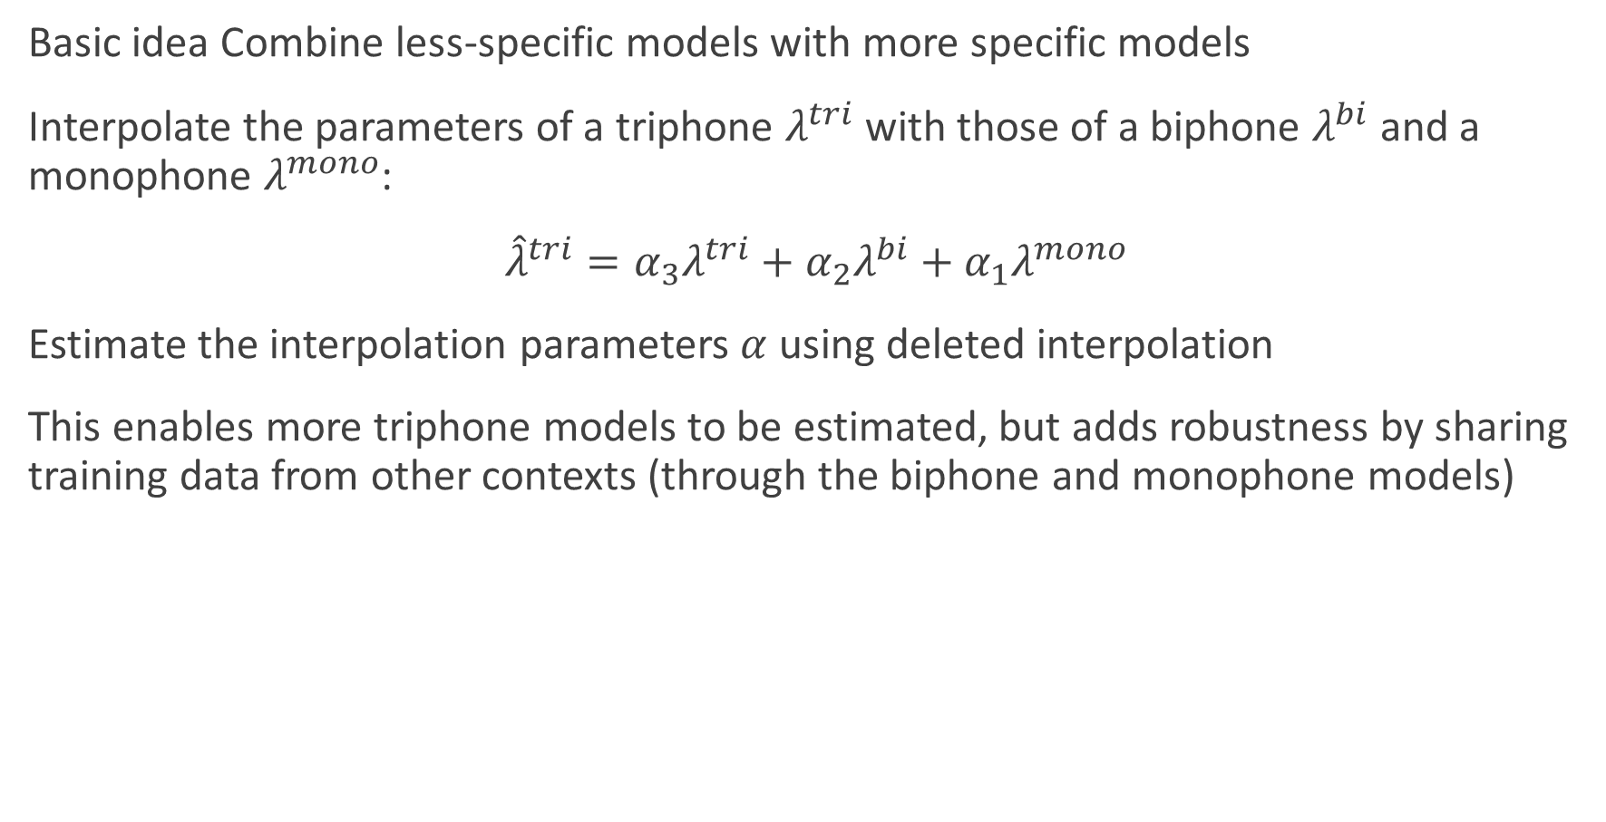
Smoothing: Interpolation
Basic idea Combine less-specific models with more specific models
Interpolate the parameters of a triphone $λ^{tri}$ with those of a biphone $λ^{bi}$ and a monophone $λ^{mono}$:
${\hat{λ}}^{tri}=α_{3}λ^{tri}+α_{2}λ^{bi}+α_{1}λ^{mono}$
Estimate the interpolation parameters $α$ using deleted interpolation
This enables more triphone models to be estimated, but adds robustness by sharing training data from other contexts (through the biphone and monophone models)

Slide 29
Parameter Sharing
Basic idea Explicitly share models or parameters between different contexts enables training data to be shared between the models enables models to share parameters
Sharing can take place at different levels
Sharing Gaussians: all distributions share the same set of Gaussians but have different mixture weights (tied mixtures)
Sharing states: allow different models to share the same states (state clustering)
Sharing models: merge those context-dependent models that are the most similar (generalized triphones)

Slide 30
Sharing Models: Generalized triphones
Basic idea Merge similar context-dependent models
Bottom-up merging: Compare allophone models with different triphone contexts and merge those that are similar
Merged models will be estimated from more data than individual models: more accurate models, fewer models in total
The resultant merged models are referred to as generalized triphones

Slide 31
Example: Generalized triphones
ax-b+ah
(ax,ae)-b+ah
ae-b+ah

Slide 32
Example: Generalized triphones
s-iy+l
f-iy+l
t-iy+n
t-iy+m
Simple triphones (no sharing)

Slide 33
Example: Generalized triphones
s-iy+l
f-iy+l
t-iy+n
t-iy+m
Simple triphones (no sharing)
(s,f)-iy+l
t-iy+(n,m)
Generalized triphones (model sharing)

Slide 34
Example: State Clustering
s-iy+l
f-iy+l
t-iy+n
t-iy+m
Simple triphones (no sharing)

Slide 35
Example: State Clustering
s-iy+l
f-iy+l
t-iy+n
t-iy+m
Simple triphones (no sharing)
s-iy+l
f-iy+l
t-iy+n
t-iy+m
State-clustered triphones (state sharing)

Slide 36
Example: State Clustering
s-iy+l
f-iy+l
t-iy+n
t-iy+m
Simple triphones (no sharing)
s-iy+l
f-iy+l
t-iy+n
t-iy+m
State-clustered triphones (state sharing)

Slide 37
Sharing States: State clustering
Basic idea States which are responsible for acoustically similar data are shared
By clustering similar states, the training data associated with individual states may be pooled together - results in better parameter estimates for the state
Create a set of context dependent models for a parent phone
Cluster and tie similar states, ensuring that each resultant clustered state is responsible for “enough” training data (ie setting a minimum state occupation count)
More flexible than clustering whole models: left and right contexts may be clustered separately

Slide 38
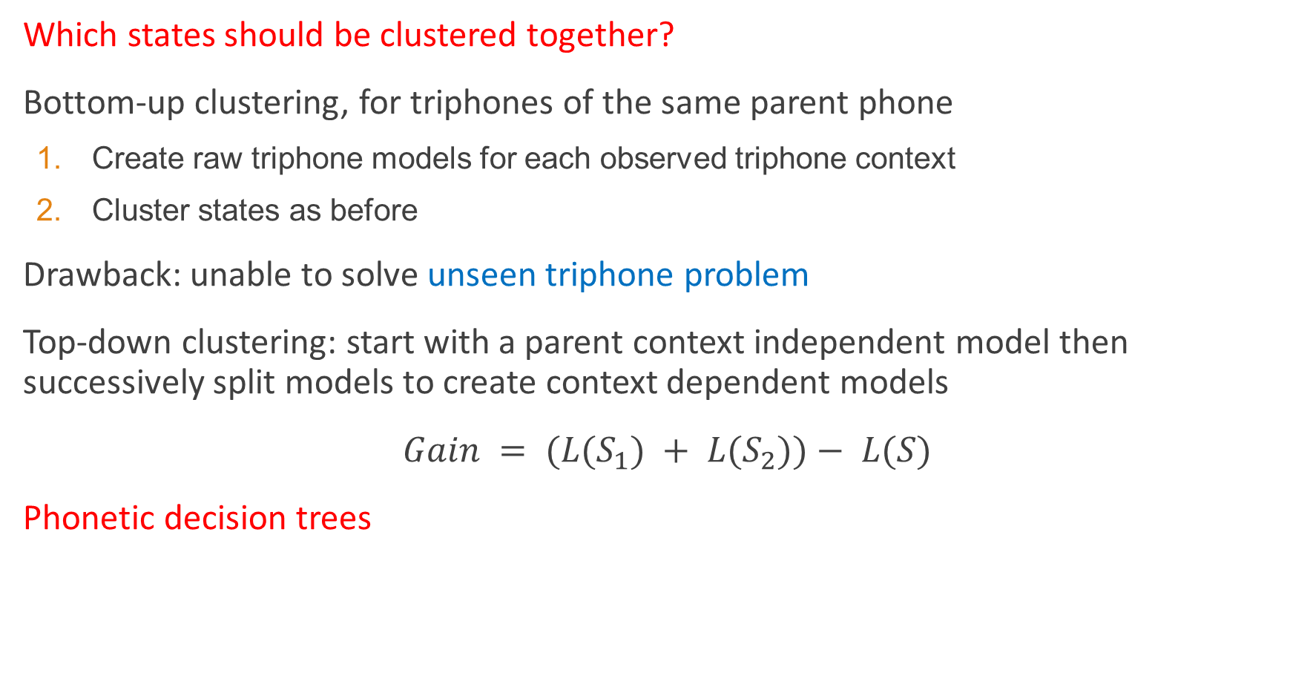
Good contexts to share
Which states should be clustered together?
Bottom-up clustering, for triphones of the same parent phone
Create raw triphone models for each observed triphone context
Cluster states as before
Drawback: unable to solve unseen triphone problem
Top-down clustering: start with a parent context independent model then successively split models to create context dependent models
$Gain = (L(S_{1}) + L(S_{2}))− L(S)$
Phonetic decision trees

Slide 39
Phonetic Decision Trees
Basic idea Build a decision tree for each state of each parent phone, with yes/no questions at each node
At the root of the tree, all states are shared
Questions split the pool of states, the resultant state clusters are given by the leaves of the tree
Example questions:
Is the left context a nasal?
Is the right context a central stop?
The questions at each node are chosen from a large set of predefined questions
Choose the question which maximizes the likelihood of the data given the state clusters
Stop splitting if either: (a) the likelihood does not increase by more than a predefined threshold; or (b) the amount of data associated with a split node would below a threshold

Slide 40
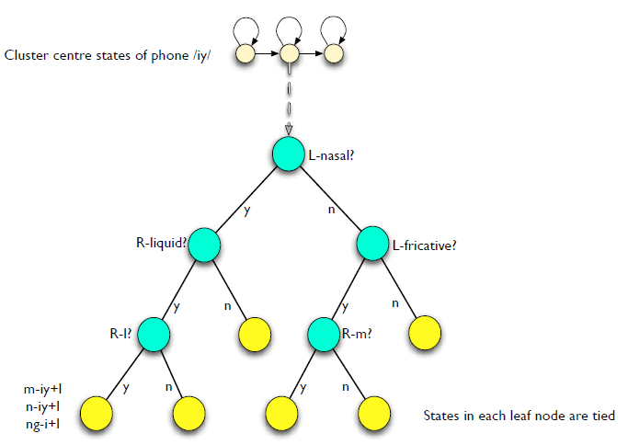
Phonetic Decision Tree
Notes:
The nine English fricative sounds:
v sound /v/
f sound /f/
voiced th sound /ð/
unvoiced th sound /θ/
z sound /z/
s sound /s/
zh sound /ʒ/
sh sound /ʃ/

Slide 41
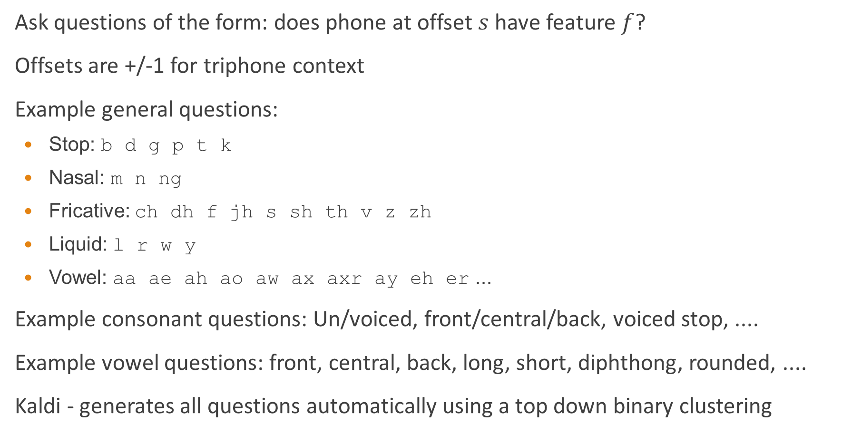
Phonetic questions
Ask questions of the form: does phone at offset $s$ have feature $f$?
Offsets are +/-1 for triphone context
Example general questions:
Stop: b d g p t k
Nasal: m n ng
Fricative: ch dh f jh s sh th v z zh
Liquid: l r w y
Vowel: aa ae ah ao aw ax axr ay eh er ...
Example consonant questions: Un/voiced, front/central/back, voiced stop, ....
Example vowel questions: front, central, back, long, short, diphthong, rounded, ....
Kaldi - generates all questions automatically using a top down binary clustering

Slide 42
Most useful phonetic questions
All states of all models:
+Vowel -Vowel +Unrounded –UnFortisLenis +UnFortisLenis +r
Entry state of all models:
-UnFortisLenis -Vowel -Nasal –CentralFront -Unrounded -Fortis
Exit state of all consonants:
+Vowel +Unrounded +High +ee +Rounded +Syllabic
(for Wall St Journal read speech – Young, Odell and Woodland 1994)

Slide 43
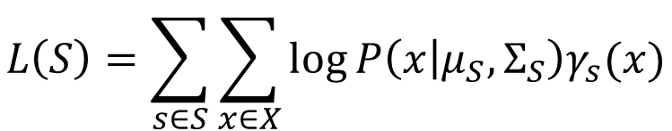
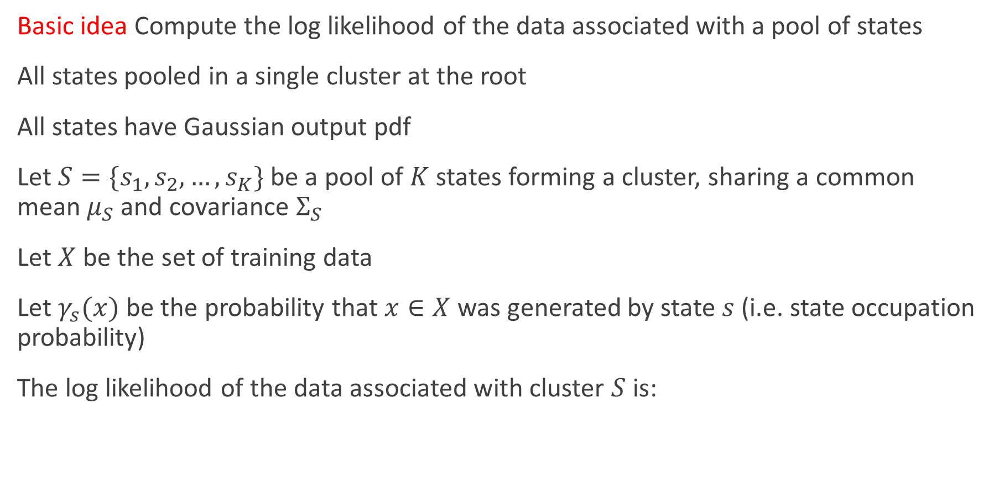
Likelihood of a state cluster
Basic idea Compute the log likelihood of the data associated with a pool of states
All states pooled in a single cluster at the root
All states have Gaussian output pdf
Let $S=\{s_{1},s_{2},…,s_{K}\}$ be a pool of $K$ states forming a cluster, sharing a common mean $μ_{S}$ and covariance $Σ_{S}$
Let $X$ be the set of training data
Let $γ_{s}(x)$ be the probability that $x∈X$ was generated by state $s$ (i.e. state occupation probability)
The log likelihood of the data associated with cluster $S$ is:
$$L\left(S\right)=\sum_{s∈S}{\sum_{x∈X}{\log{P\left(x | μ_{S},Σ_{S}\right)γ_{s}(x)}}}$$

Slide 44
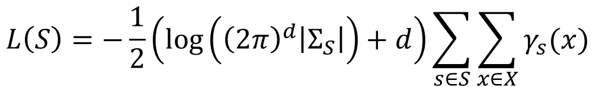
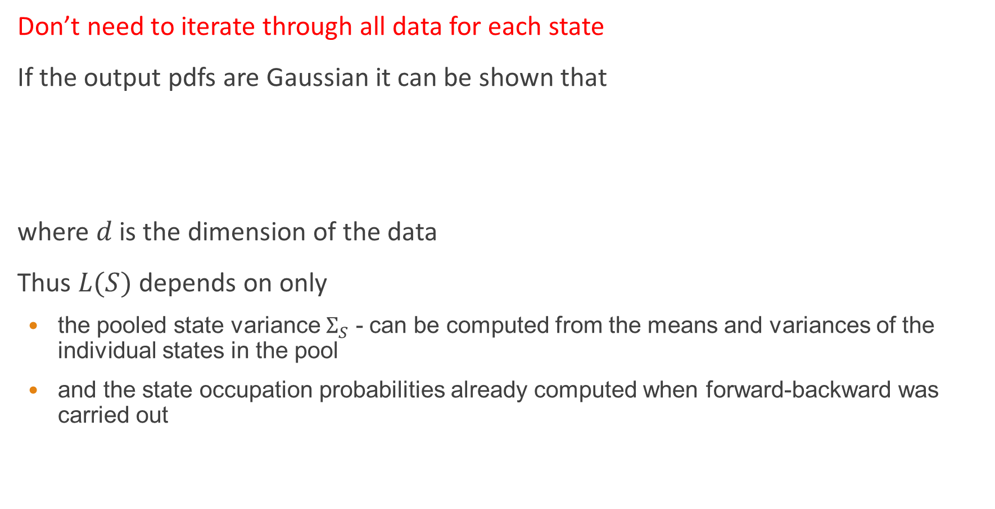
Likelihood of a state cluster
Don’t need to iterate through all data for each state
If the output pdfs are Gaussian it can be shown that
where $d$ is the dimension of the data
Thus $L(S)$ depends on only
the pooled state variance $Σ_{S}$ - can be computed from the means and variances of the individual states in the pool
and the state occupation probabilities already computed when forward-backward was carried out
$$L\left(S\right)=−\frac{1}{2}\left(\log\left({\left(2π\right)}^{d}\left|Σ_{S}\right|\right)+d\right)\sum_{s∈S}{\sum_{x∈X}{γ_{s}(x)}}$$

Slide 45
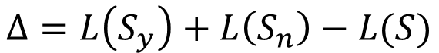
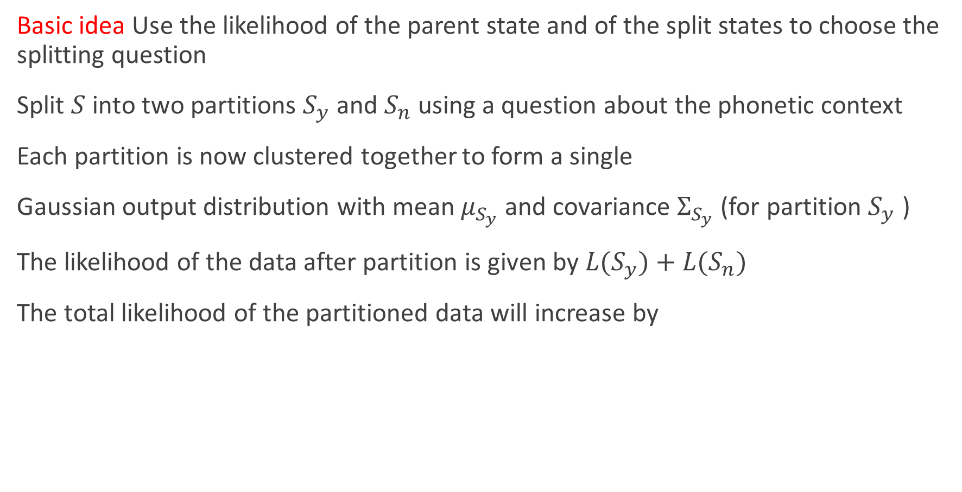
State splitting
Basic idea Use the likelihood of the parent state and of the split states to choose the splitting question
Split $S$ into two partitions $S_{y}$ and $S_{n}$ using a question about the phonetic context
Each partition is now clustered together to form a single
Gaussian output distribution with mean $μ_{S_{y}}$ and covariance $Σ_{S_{y}}$ (for partition $S_{y}$ )
The likelihood of the data after partition is given by $L(S_{y})+L(S_{n})$
The total likelihood of the partitioned data will increase by
$$Δ=L\left(S_{y}\right)+L\left(S_{n}\right)−L(S)$$

Slide 46
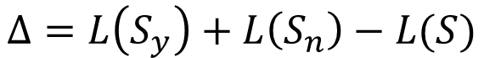
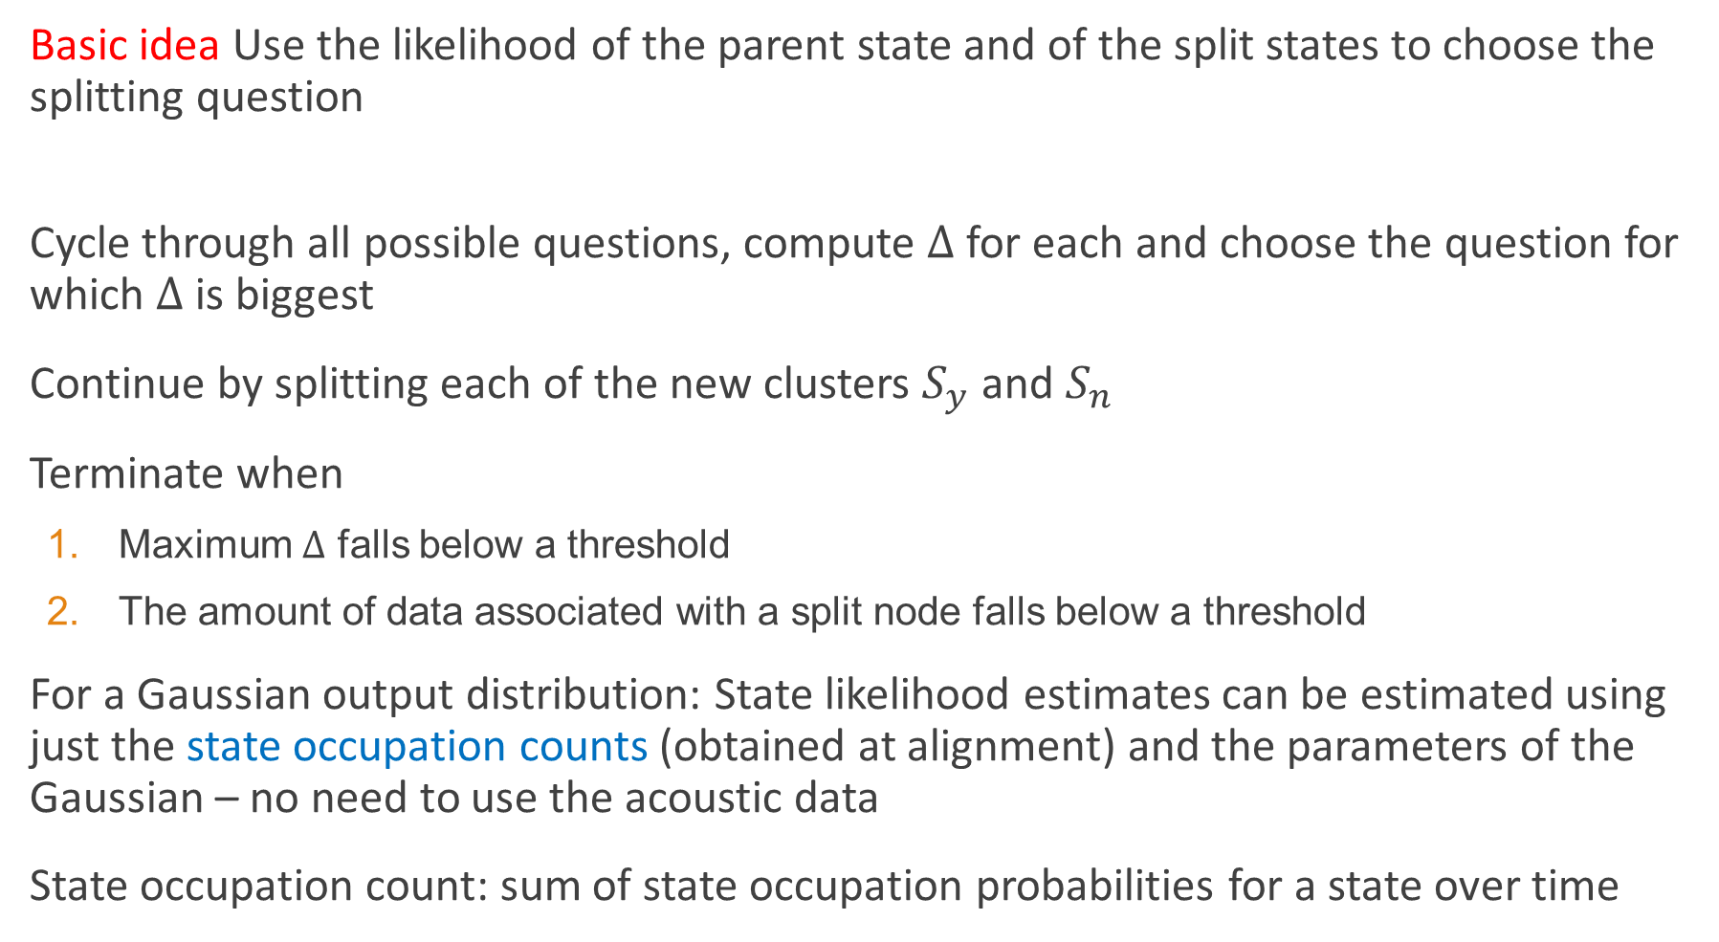
State splitting
Basic idea Use the likelihood of the parent state and of the split states to choose the splitting question
Cycle through all possible questions, compute $Δ$ for each and choose the question for which $Δ$ is biggest
Continue by splitting each of the new clusters $S_{y}$ and $S_{n}$
Terminate when
Maximum $Δ$ falls below a threshold
The amount of data associated with a split node falls below a threshold
For a Gaussian output distribution: State likelihood estimates can be estimated using just the state occupation counts (obtained at alignment) and the parameters of the Gaussian – no need to use the acoustic data
State occupation count: sum of state occupation probabilities for a state over time
$$Δ=L\left(S_{y}\right)+L\left(S_{n}\right)−L(S)$$

Slide 47
“Mixing up”
Basic idea Transforming an HMM-based system based on Gaussian distributions to one based on mixtures of Gaussians
The above methods for state clustering assume that the state outputs are Gaussians – this makes the computations much simpler
BUT: Gaussian mixtures offer much better acoustic models than Gaussians
Solution:
Perform state clustering using Gaussian distributions
Split the Gaussian distributions in the clustered states, by cloning and perturbing the means by a small fraction of the standard deviation, and retrain.
Repeat by splitting the dominant (highest state occupation count) mixture components in each state

Slide 48
“Mixing up”
s-iy+l
f-iy+l
t-iy+n
t-iy+m
State-clustered triphones (Gaussians)
s-iy+l
f-iy+l
t-iy+n
t-iy+m
0.4
0.4
0.4
0.4
0.4
0.4
0.35
0.35
0.35
0.35
0.35
0.35
0.3
0.3
0.3
0.3
0.3
0.3
0.25
0.25
0.25
0.25
0.25
0.25
0.2
0.2
0.2
0.2
0.2
0.2
0.15
0.15
0.15
0.15
0.15
0.15
0.1
0.1
0.1
0.1
0.1
0.1
0.05
0.05
0
0.05
0.05
0.05
0.05
0
-4
-3
-2
-1
0
1
2
3
4
0
0
0
0
-4
-3
-2
-1
0
1
2
3
4
-4
-3
-2
-1
0
1
2
3
4
-4
-3
-2
-1
0
1
2
3
4
-4
-3
-2
-1
0
1
2
3
4
-4
-3
-2
-1
0
1
2
3
4
State-clustered triphones (GMMs)

Slide 49
Summary: Context-dependent phone models
Share parameters through state clustering
Cluster states using phonetic decision trees for each state of parent phone
Use Gaussian distributions when state clustering
Then split Gaussians and retrain to obtain a GMM state clustered system

